Slide 1
Madrid real estate market

Slide 2
Real Estate Market
Real estate in Madrid, Spain is a hot commodity. Understanding when to invest in the market could lead to profitable outcomes in terms of revenue.
For generating financial gains, it is vital to gauge the prices of properties in the future.
Therefore, correctly predicting the prices of real estate properties plays a huge role.
In this prediction model, we specifically focus on what factors are important in predicting the prices.

Slide 3
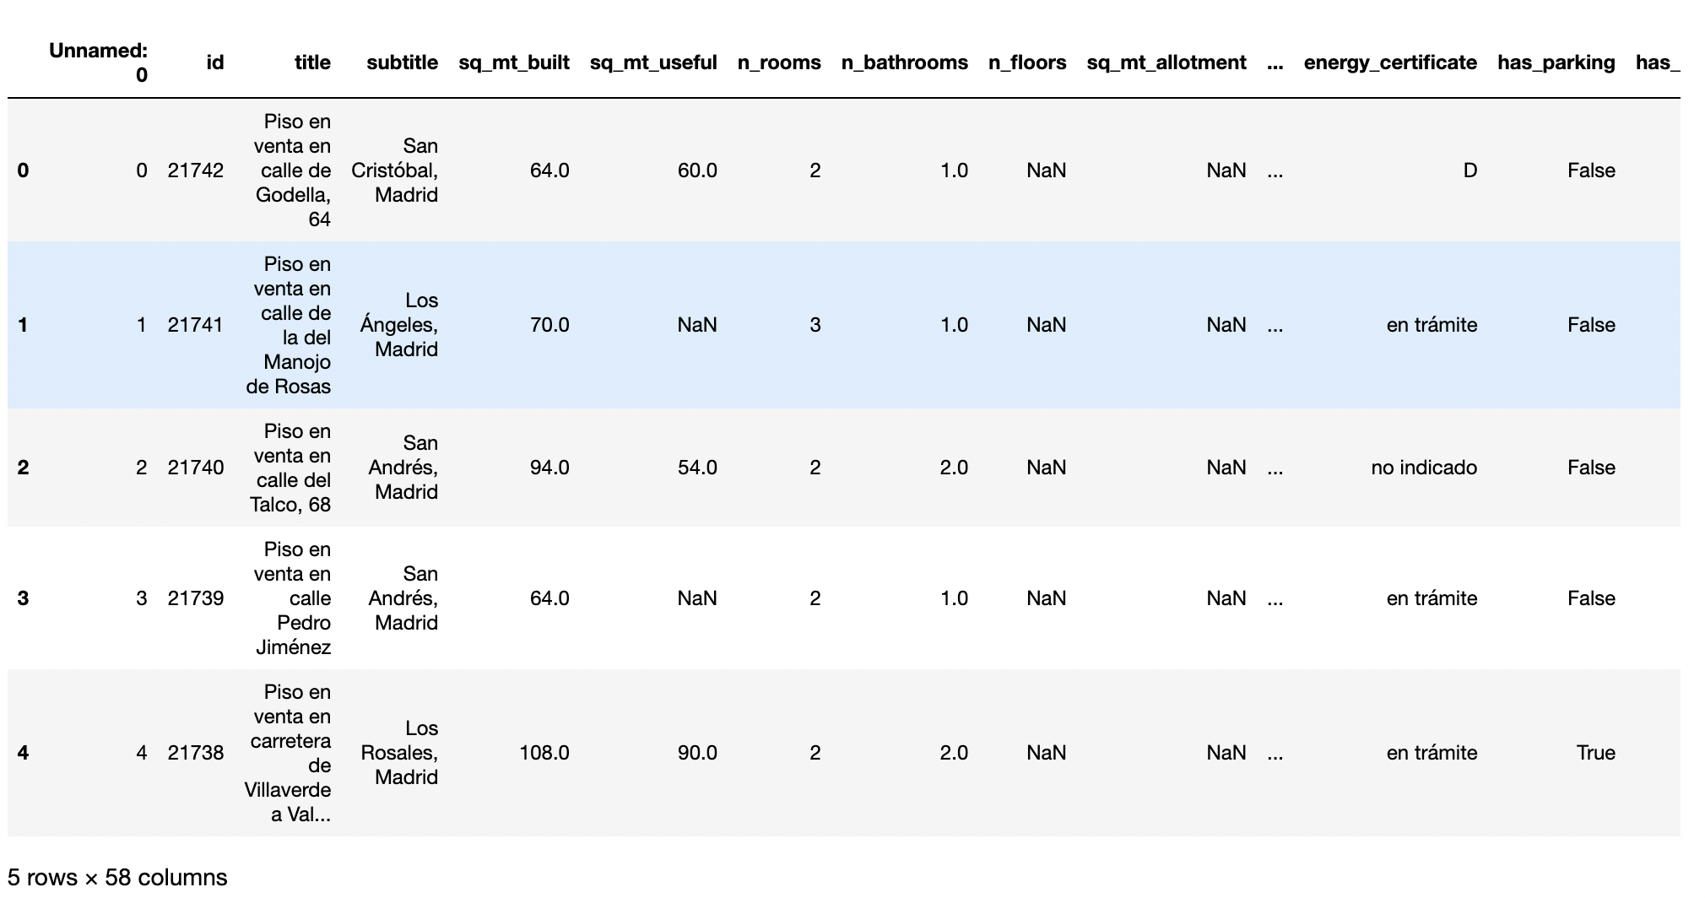
Dataset
Our dataset consists of 58 attributes and 21742 observations.
The variables are numerical or categorical.
Here is a snippet of the head of our dataset.

Slide 4
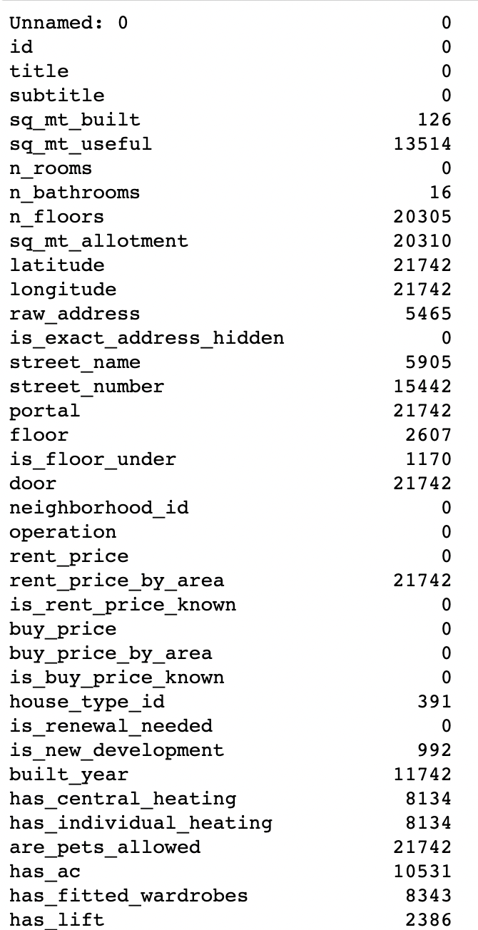
Exploratory Data Analysis
The first step is understanding our dataset. Then figuring out what columns to discard and what columns to include.
To begin with, we check the number of missing/NA values in our columns.
A snippet of the number of missing values for columns is provided.
Based on this information, we can delete columns that have all missing values or majority of missing values.

Slide 5
Contd..
Columns that had all, or majority of NA values were removed from the dataset.
Also a correlation matrix was created to further identify unimportant columns, but it did not prove to be useful.
In the next slide a screenshot is provided of the correlation matrix. No conclusive evidence could be drawn from that.
Hence deleting columns based on their correlation wasn’t the way to move forward.

Slide 6
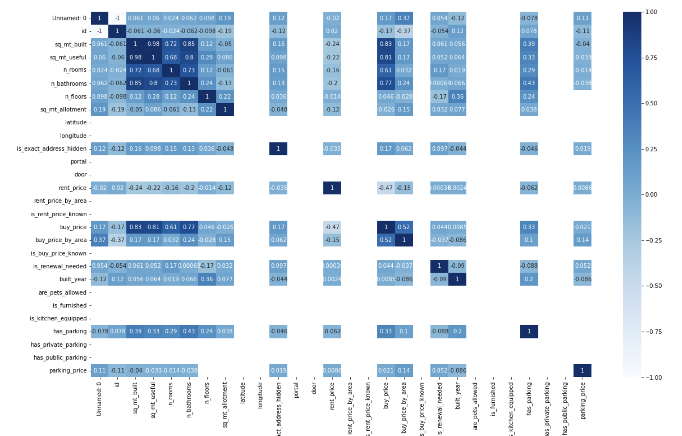

Slide 7
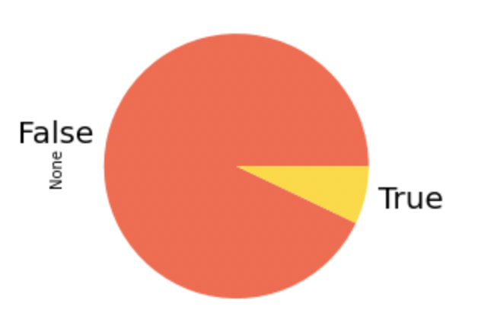
Contd..
Another strategy that was incorporated was to check for imbalance in the attributes. Specifically for categorical attributes if majority of values were of a specifically value and the rest did not constitute a significant amount, then those columns were excluded from the working data frame as well.
Here is an example of ‘is_new_development’ column.
Here majority of values are ‘False’.
So similar columns of this nature were removed.

Slide 8
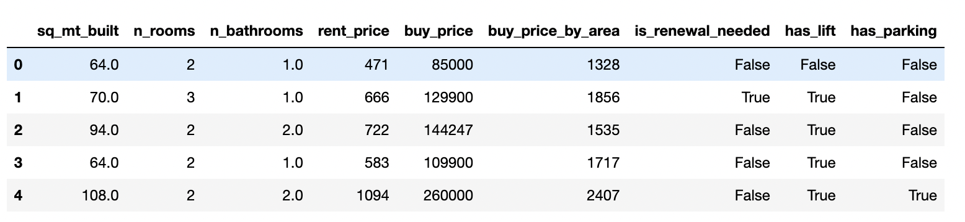
Contd..
Finally after all the exploration of features the working columns were narrowed down.
A screenshot is provided of the head of the data frame

Slide 9
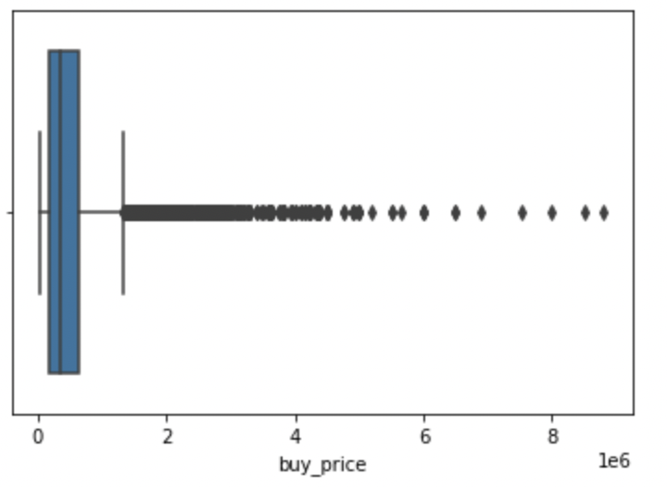
Understanding the target variable
Our target variable is ‘buy_price’.
First, let’s understand how is it distributed. For that a box plot is provided.
It is evident that it contains several outliers

Slide 10
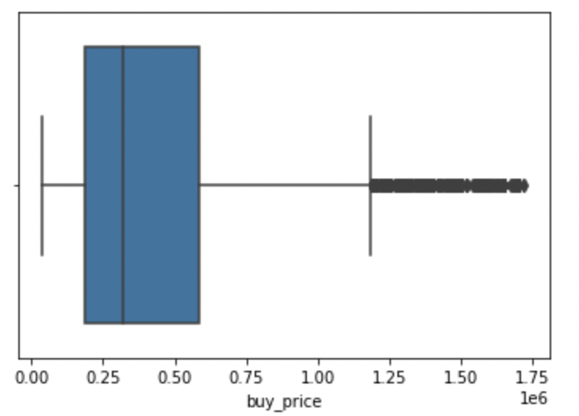
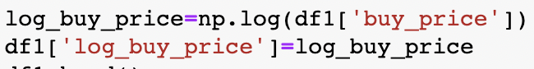
Contd..
To deal with outliers in our target variable, we change the distribution to logarithmic and remove values from the 95th percentile onwards.
After the above changes are made, we observe from the second box plot there is just a minority of outliers present if at all.

Slide 11
One Hot Encoding for categorical variables
For categorical variables, one hot encoding was performed for specifically three variables in our data frame.
A code snippet below shows the operation

Slide 12
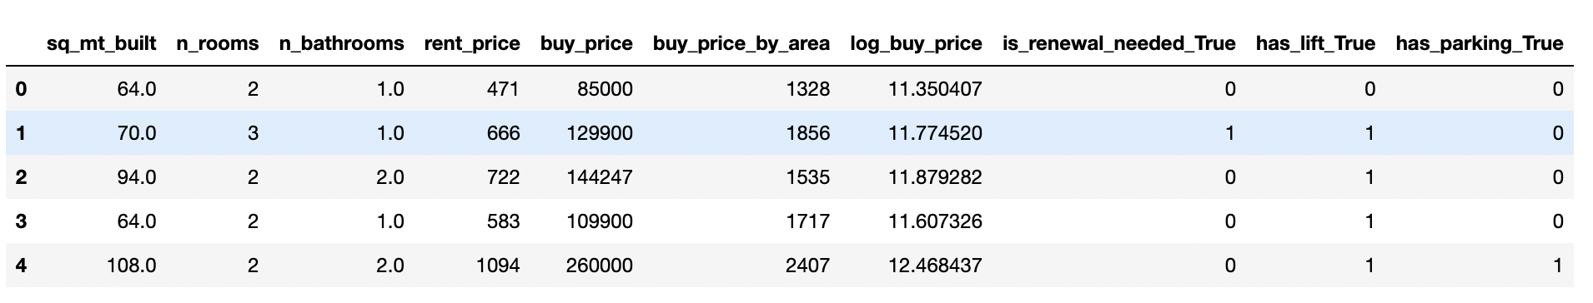
Final data frame for model building
After the initial analysis and various operations. Our final dataset is formed for model building.
Here is a screenshot of the data frame.

Slide 13
Model Building
We make use of two machine learning algorithms. Those are :
1) Linear Regression
2) Random Forest Regressor

Slide 14
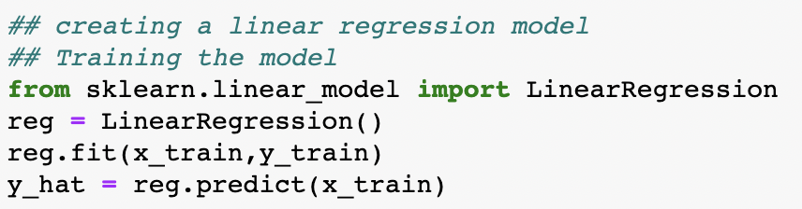
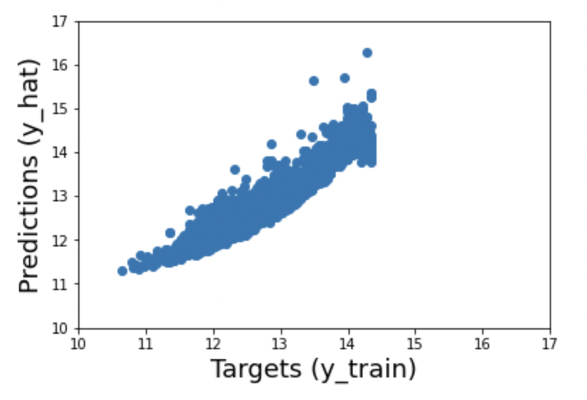
Linear Regression
First, we split the train and test data into 70: 30, respectively.
Next, we train the model on our train set.
A code snippet is provided for training the model.
Next, we visualize the prediction from the training data

Slide 15
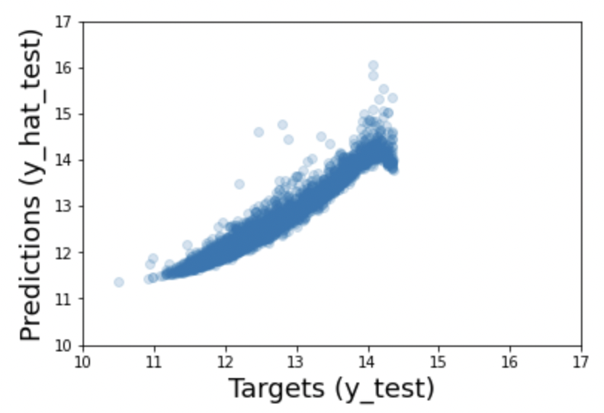
Contd..
Now, we test the model on our test data.
After fitting the test data into our model, we plot the prediction using a scatterplot to understand the predictions.
From the plot it is clearly seen that for extreme values the model finds it difficult to predict correctly.
But for values lying in the mid range, the model predicts it correctly
The r-squared value is 0.94 which indicated that much of the variability is explained by our model

Slide 16
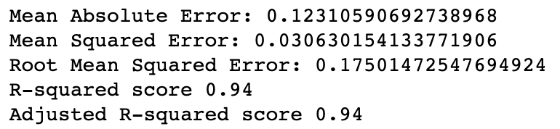
Contd..
We generate certain metrices from the linear regression model.
The values are displayed with the help of a screenshot

Slide 17
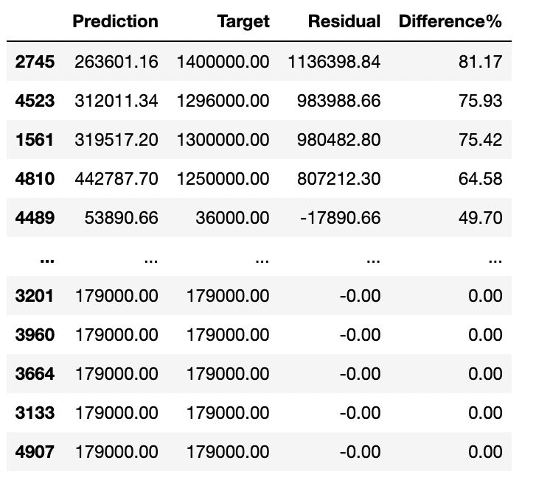
Contd..
Finally, we check our predictions against the actual values to totally understand the efficiency and accuracy of our model.
The results are shown with the aid of a screenshot.

Slide 18
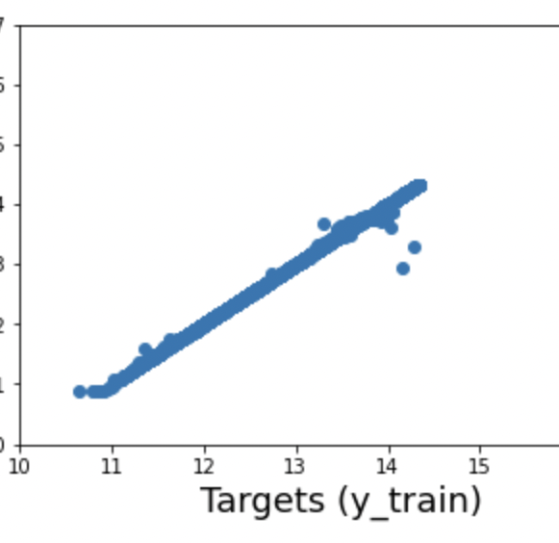
Random Forest Regressor
For this model, we first make use of RandomizedSearchCV to find the best parameters for our model.
We also define a dictionary of features for our random search.
After fitting our train data into the model, we again make use of a scatterplot to better visualize the results.

Slide 19
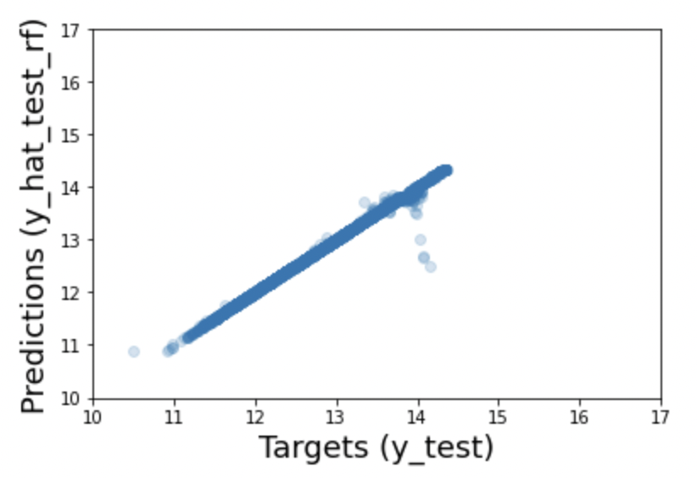
Contd..
Next, we move on to testing our data.
After making predictions on the test data, we generate the following scatterplot.
Here we observe that for lower limit values the model does not predict accurately.
For the mid range values, the model predicts the prices quite accurately.

Slide 20
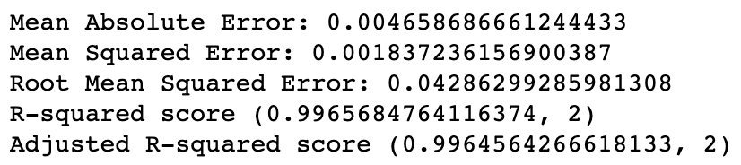
Contd..
We then generate a few metrices for our model.
With the help of a screenshot those metrices a displayed.

Slide 21
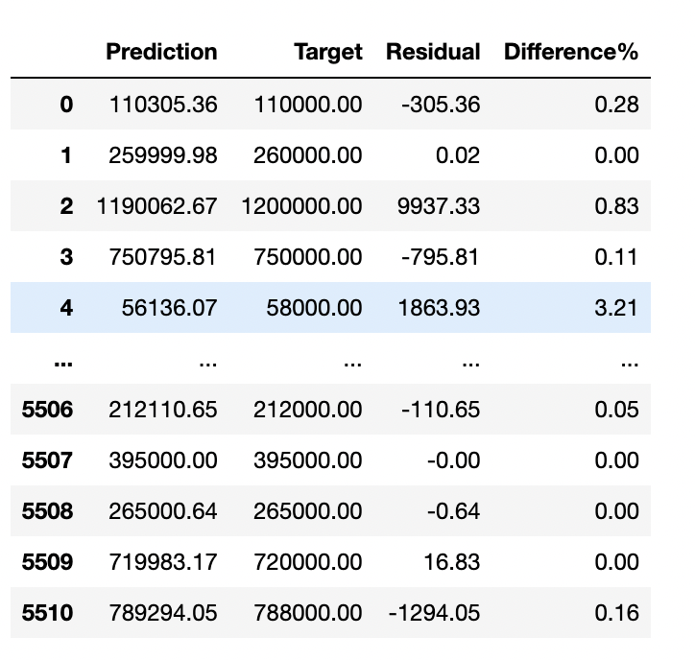
Contd..
Finally, we check our predictions against the actual prices to understand the accuracy of our model.
The table depicts the results drawn from testing our model.

Slide 22

References
towardsdatascience.com
analyticsvidhya.com
stackoverflow.com
pandas.pydata.org

